Slide 1
Introduction to Concurrent Programming with GPUs
CUDA IDE Programming
Notes:
As a long time developer, this video lecture on IDE programming for CUDA is of particular interest to me and I hope to you.

Slide 2
Integrated Development Environments
JetBrains CLion
NSight Eclipse Edition
NSight Visual Studio / VS Code
Text Editors
Build Tools
Notes:
The First 3 IDE options are the most advanced and popular environments for CUDA Development.
While they have less bells and whistles, text editors still have a very important role in CUDA development.
Though they are not editors of code, build tools in conjunction with IDEs and editors make a complete development and build process for your CUDA code

Slide 3
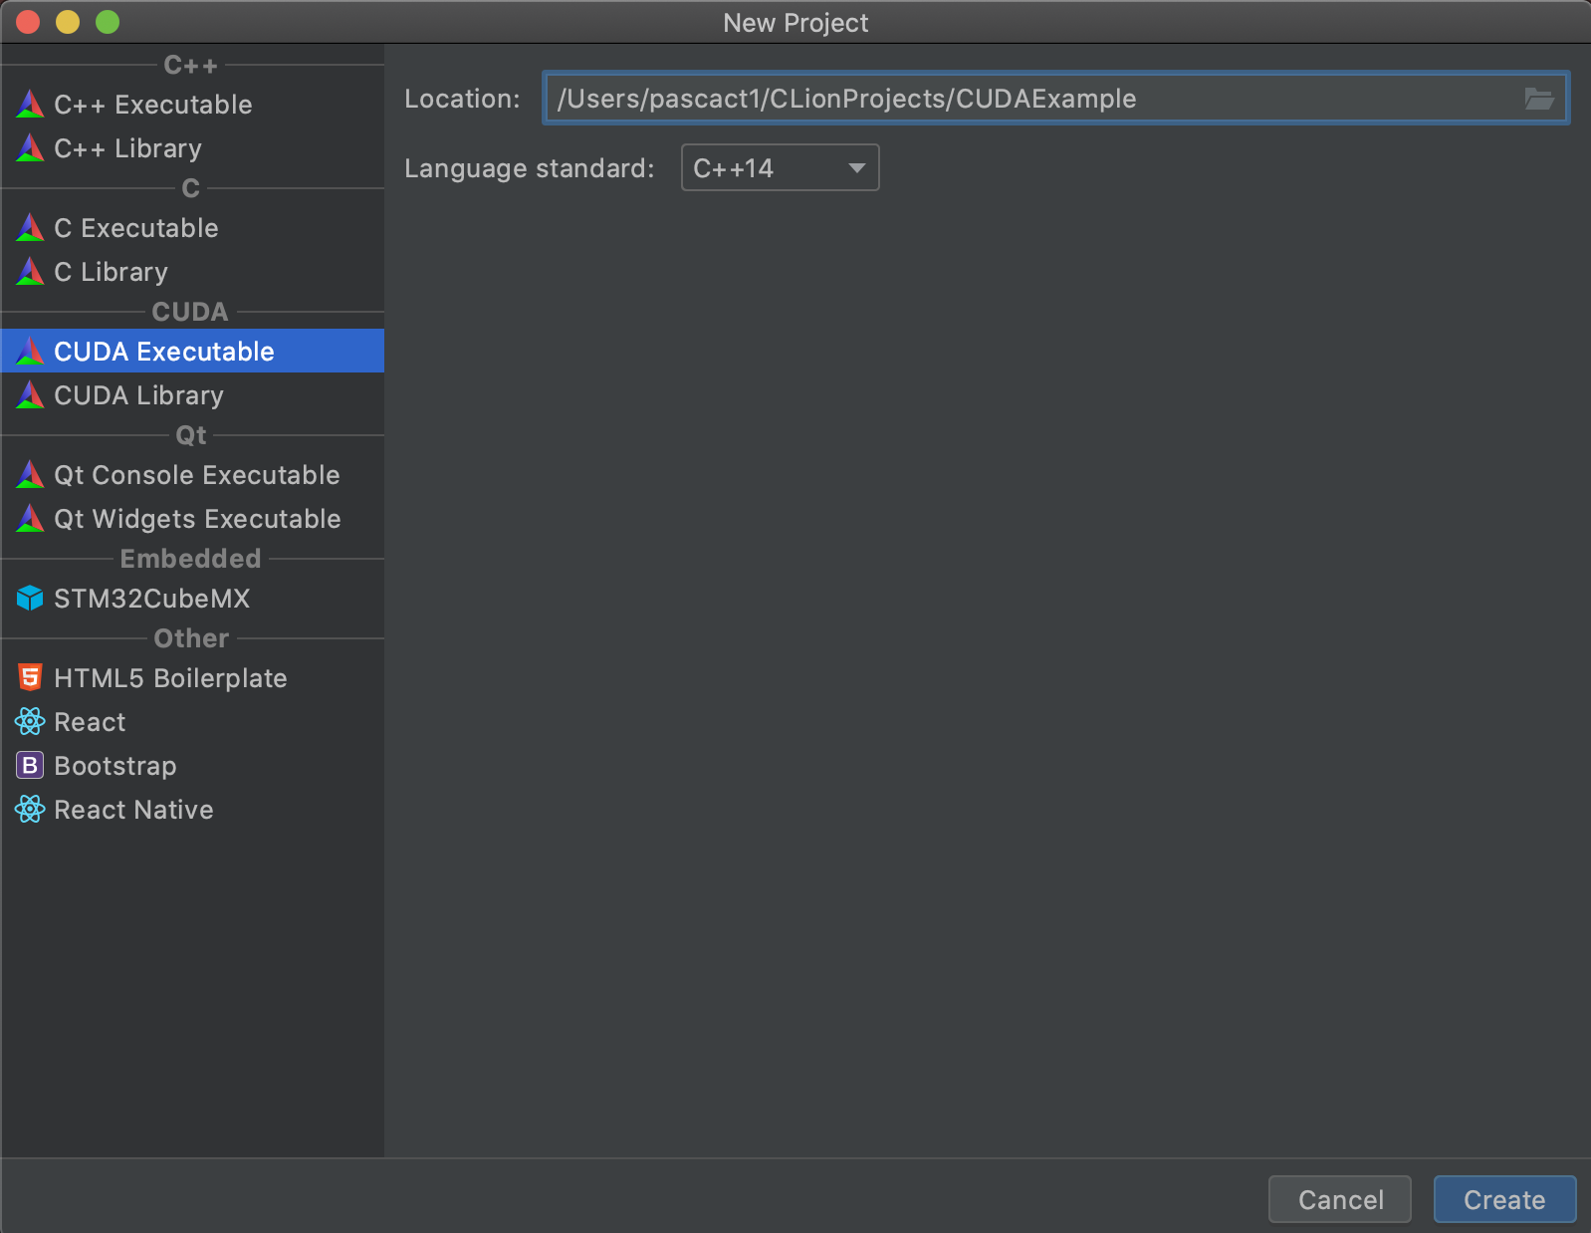
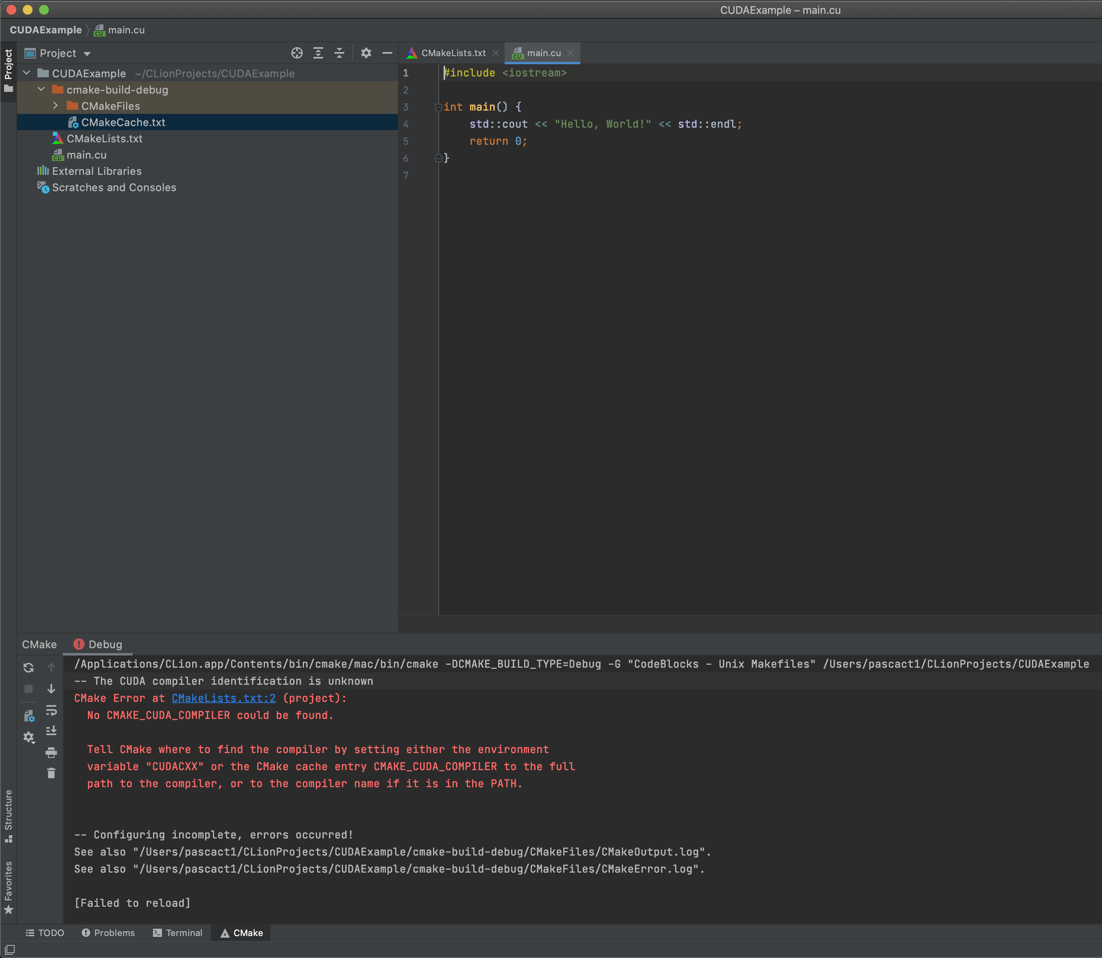
JetBrains CLion
Notes:
The JetBrain suite of IDEs includes CLion, which doesn’t include any specific capabilities for debugging and profiling CUDA GPU code.
It does include integration with the Cmake build tool and includes a new CUDA project wizard for creating a the basic structure for a CUDA project with Cmake build files included.
Along with project structure, the IDE also provides capabilities such as code completion, general C/C++ formatting, and other aids to the development process.

Slide 4
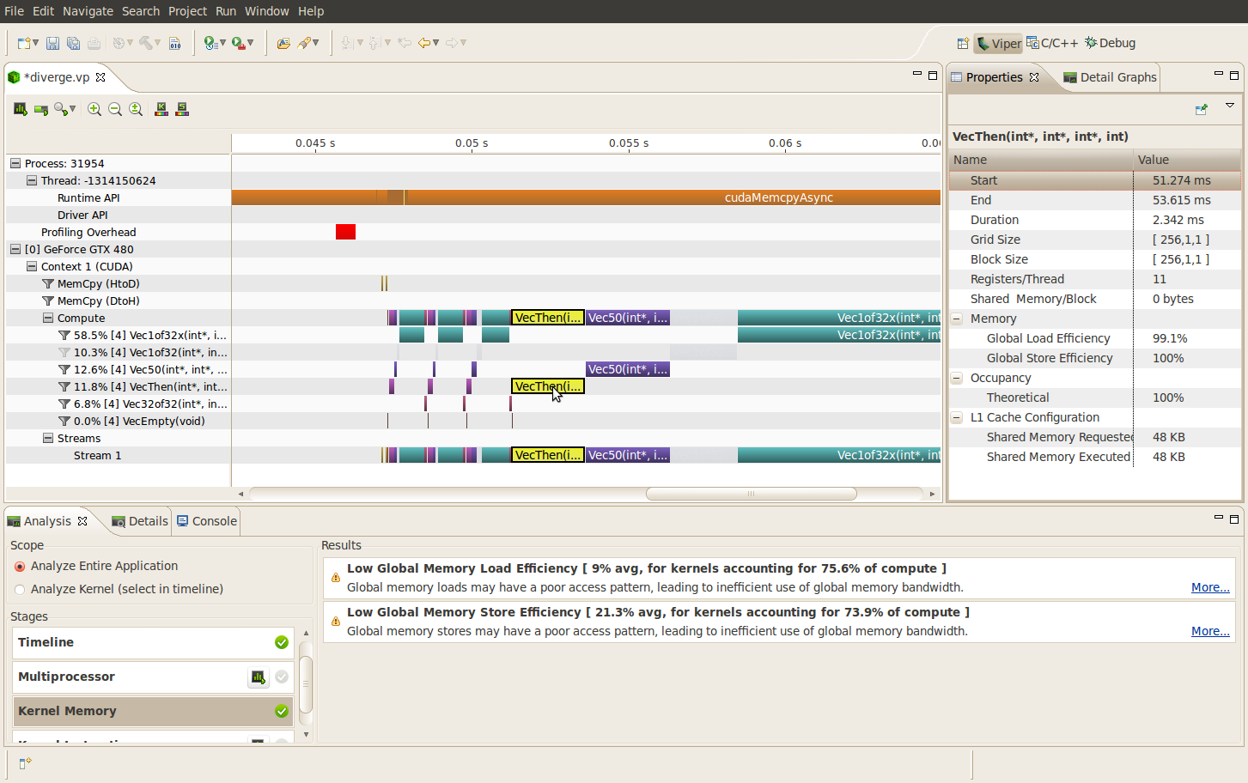
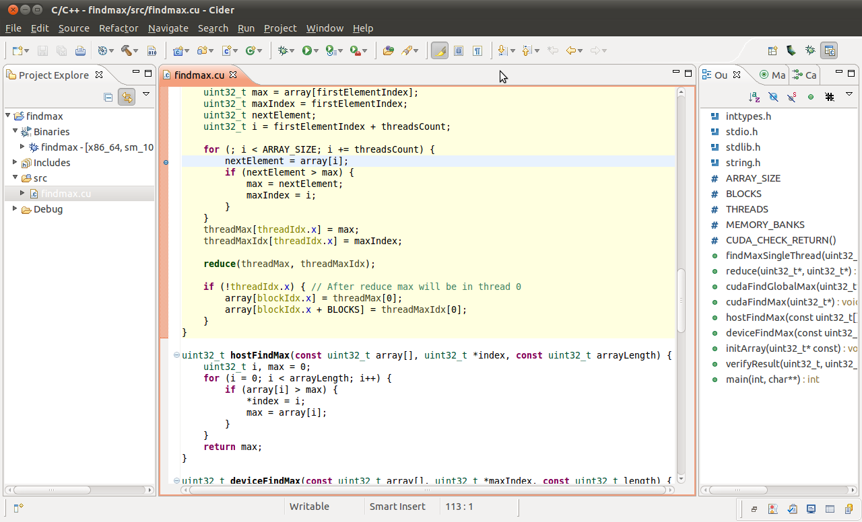
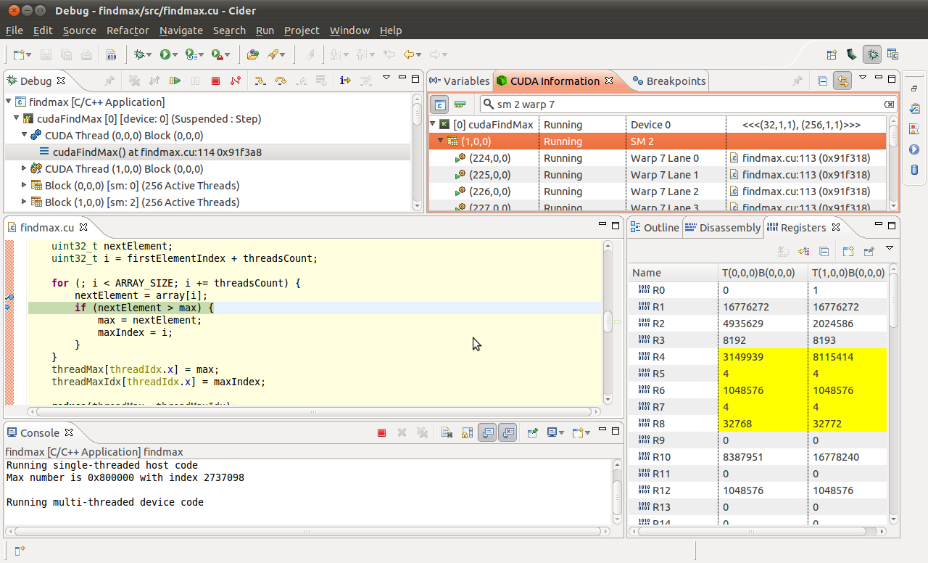
NSight Eclipse Edition
[1]
Notes:
Eclipse, while originally a Java editor, has numerous variants including one that allows for profiling and debugging CUDA projects with the Nsight plugins.
A major advantage of this editor is the ability to have a general IDE that can change based on the target project, automatically.
Java will need to be installed on the machine to run the IDE, but that is pretty common these days or at least it can be easily installed.

Slide 5
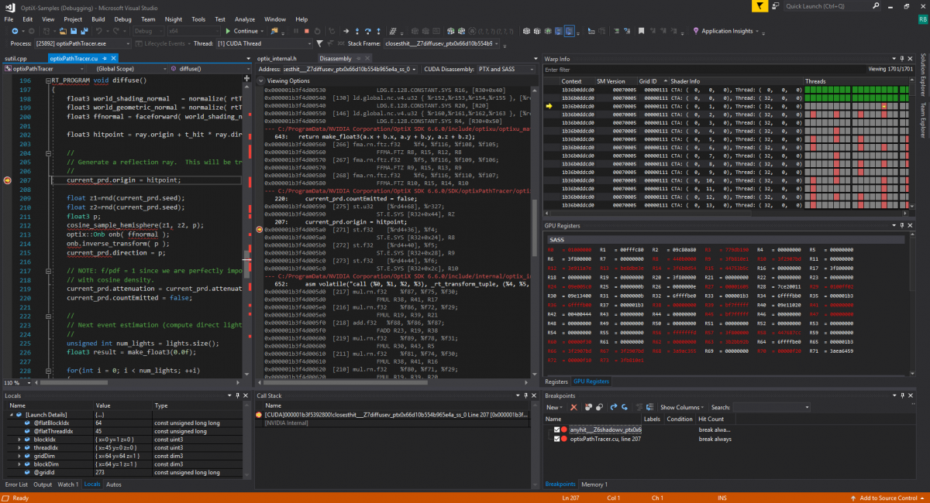
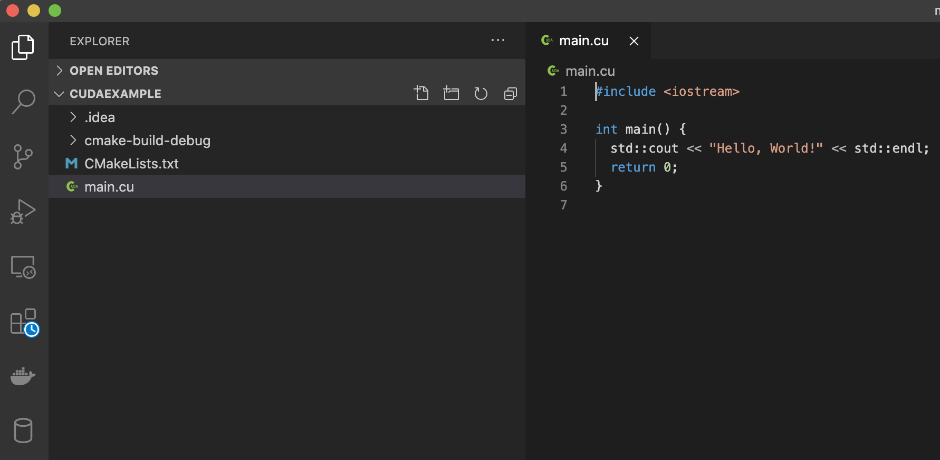
NSight Visual Studio / VS Code
Visual Studio
VS Code
Notes:
Microsoft provides a fully featured IDE, Visual Studio, that includes numerous integration points for CUDA development including profiling and debugging.
It is probably the best option for development on Windows-based machines, as it is the most fully featured.
VS Code is a supercharged text editor built for general use with many plugins available via a marketplace that allow for syntax assistance, short cuts for generating memory management code.

Slide 6
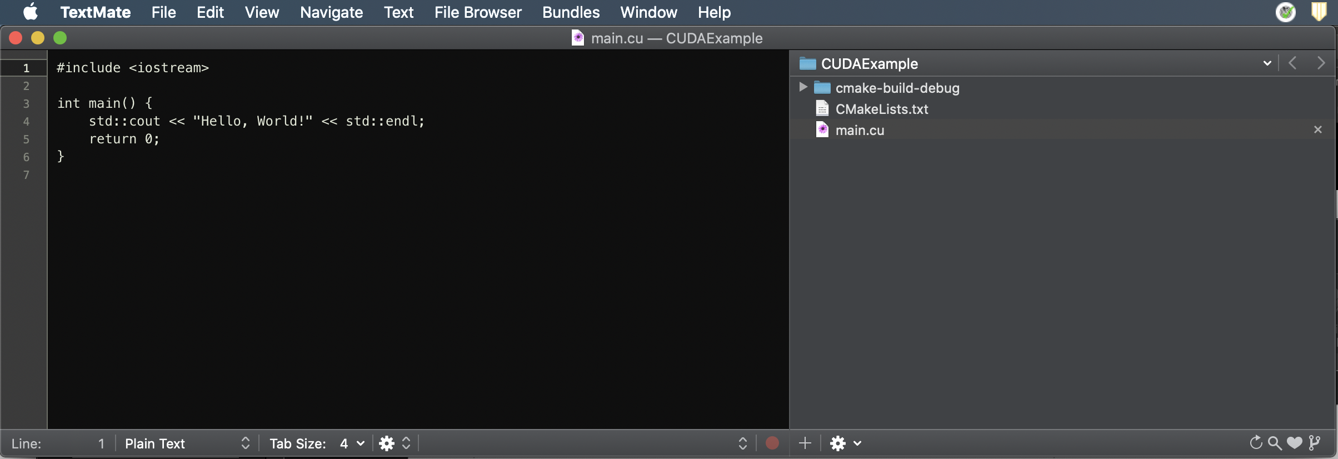
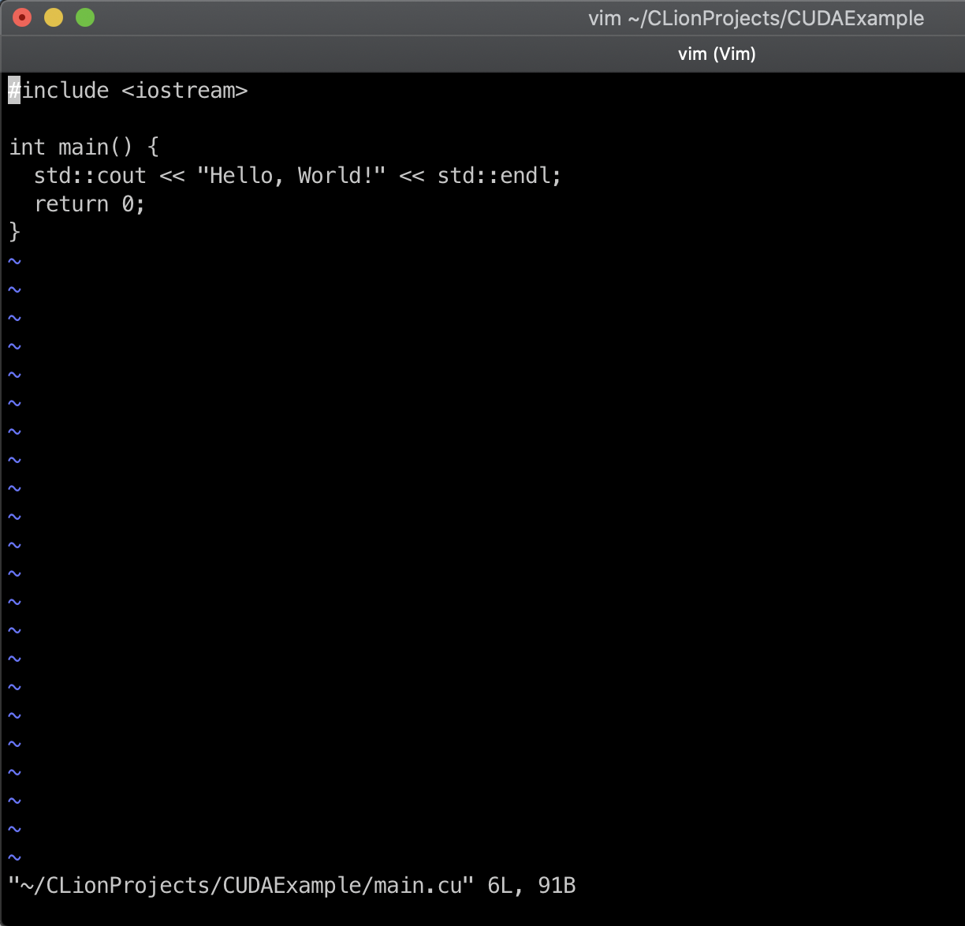
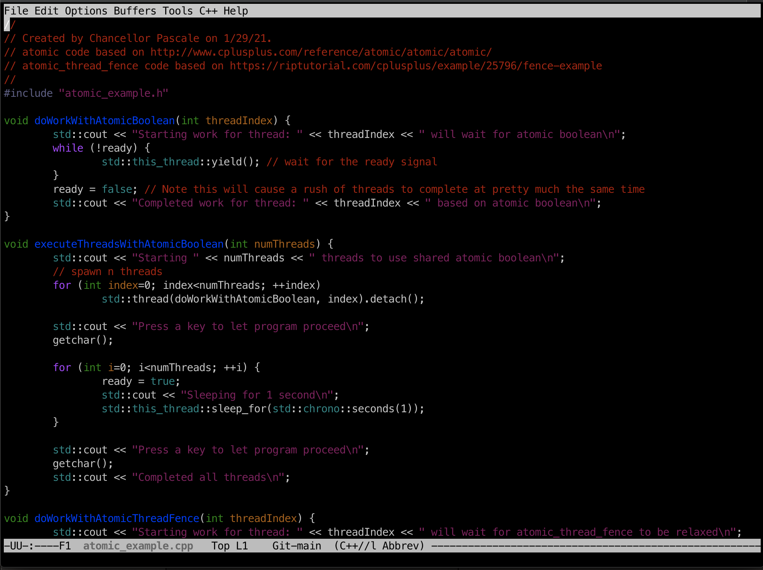
Text Editors
TextMate
vim
emacs
Notes:
Text editors don’t often provide all of the features of IDEs but they can be augmented with plugins.
Based on your preferences vim and emacs are two very good Linux command line tools for editing your code.
They can make tasks like code replacement, syntax highlighting and project structure navigation easier.
TextMate and similar modern GUI text editors are available for most OS’s and have can support the editing of the various files within a project.

Slide 7
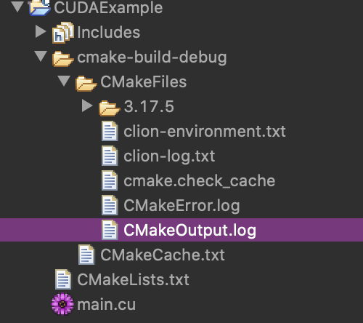
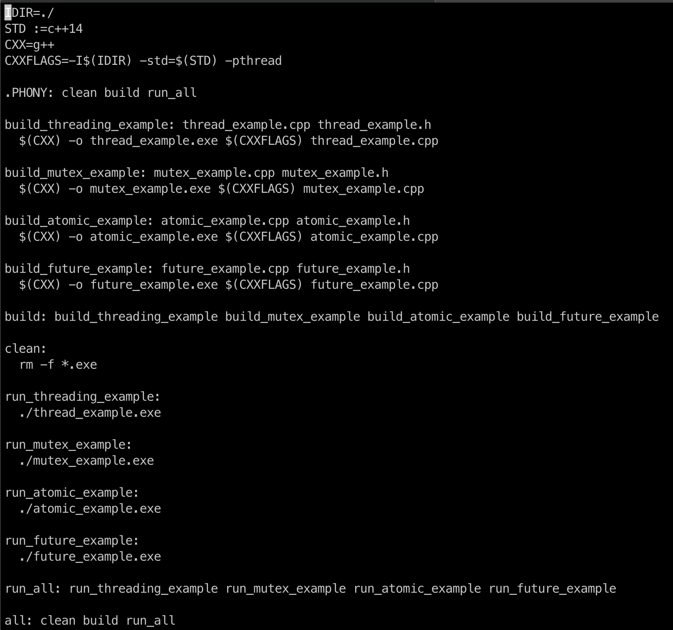
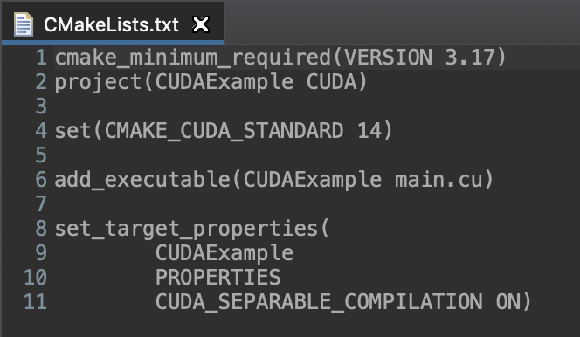
Build Tools
Make
Cmake
Notes:
Build tools take the code for a project and their own configuration files and compile the code according to targets.
Make uses a single Makefile that includes Bash style environment variable declaration, regex-based identification of code, object files, and bash scripting to execute simple to complex and hierarchical builds.
Cmake is a more modern and programmatic build tool.
In the example, Cmake is told which version of Cmake to use, the standard C++, which files to compile, and how to compile the code.

Slide 8
Bibliography
[1] 2021. nvidia.com Nsight Eclipse Edition. Retrieved from https://developer.nvidia.com/nsight-eclipse-edition.
[2] 2021. nvidia.com Nsight Visual Studio Edition. Retrieved from https://developer.nvidia.com/nsight-visual-studio-edition.

